Slide 1

Daily
Maths
Meeting

Slide 2
WHTEBEAM CLASS

Slide 3
Complete the sequences
21, 19, 17, ___, ___, ___
46, 56, 66, ___, ___, ___
127, 117, 107, ____, ____, ____
Describe each sequence to your partner

Slide 4
Complete the sequence and then explain your reasoning
13 15 17 19 21 23
51 46 41 36 31 26

Slide 5
Complete the sequence and then explain your reasoning
23 33 43 53 63 73
75 70 65 60 55 50

Slide 6
Complete the statement:
5 x 3 = ? - ?
Convince your partner you are correct
Are there any other possibilities?
What number could not be ___?
Can you think of any generalisations to express what numbers could be at ___?

Slide 7
Complete the statements using < > or -:
45 54
98 28
125 152
6 x 5 40 -10
8 x2 8 + 8 16 X 0
Convince your partner you are correct

Slide 8
Tell your partner the answer.
5 + 5 =
15 + 5 =
What do you notice? What would the next calculation be
25 + 5 =
35+ 5 =

Slide 9
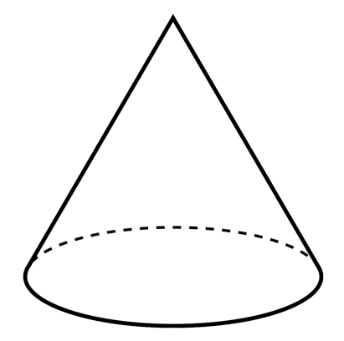
Name this shape.
Describe it’s faces?
How many vertices does it have?
How many edges does it have?

Slide 10
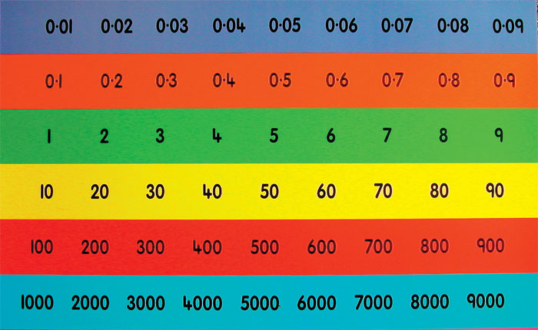
Divide the number by 10
50 divided by 10 equals ……….

Slide 11
Divide the number by 10
500 divided by 10 equals ……….
Divide the number by 100

Slide 12
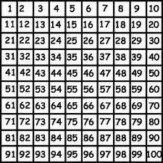
-10
Use a 100
square to help.
-100
135
+100
+10

Slide 13
-10
Use a 100
square to help.
-100
420
+100
+10

Slide 14

What fraction is shaded? What fraction is not shaded?

Slide 15

What fraction is shaded? What fraction is not shaded?
Is there more than fraction it could be?

Slide 16

What fraction is shaded? What fraction is not shaded?

Slide 17
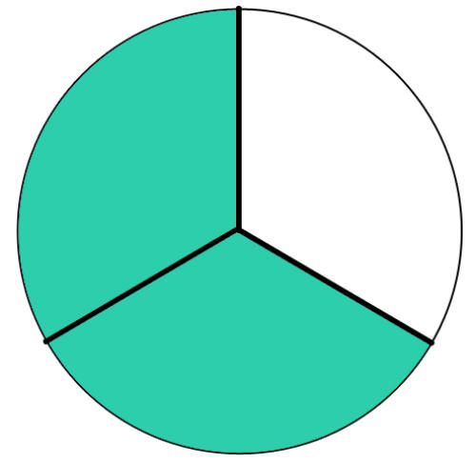
What fraction is shaded? What fraction is not shaded?

Slide 18
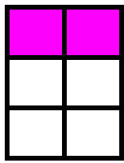

Are these fractions the same? Explain your thinking.

