Slide 2
Aim
I can name and locate the main rivers and seas of the UK.
I can identify rivers and seas using an atlas or map.
Success Criteria
I can name the seas surrounding the UK.
I can name some of the UK’s main rivers.
I can name the seas some rivers flow into.
I can find the names of seas on a map.
I can find the names of rivers on a map.
I can follow a river on a map to find where it starts and ends.

Slide 3







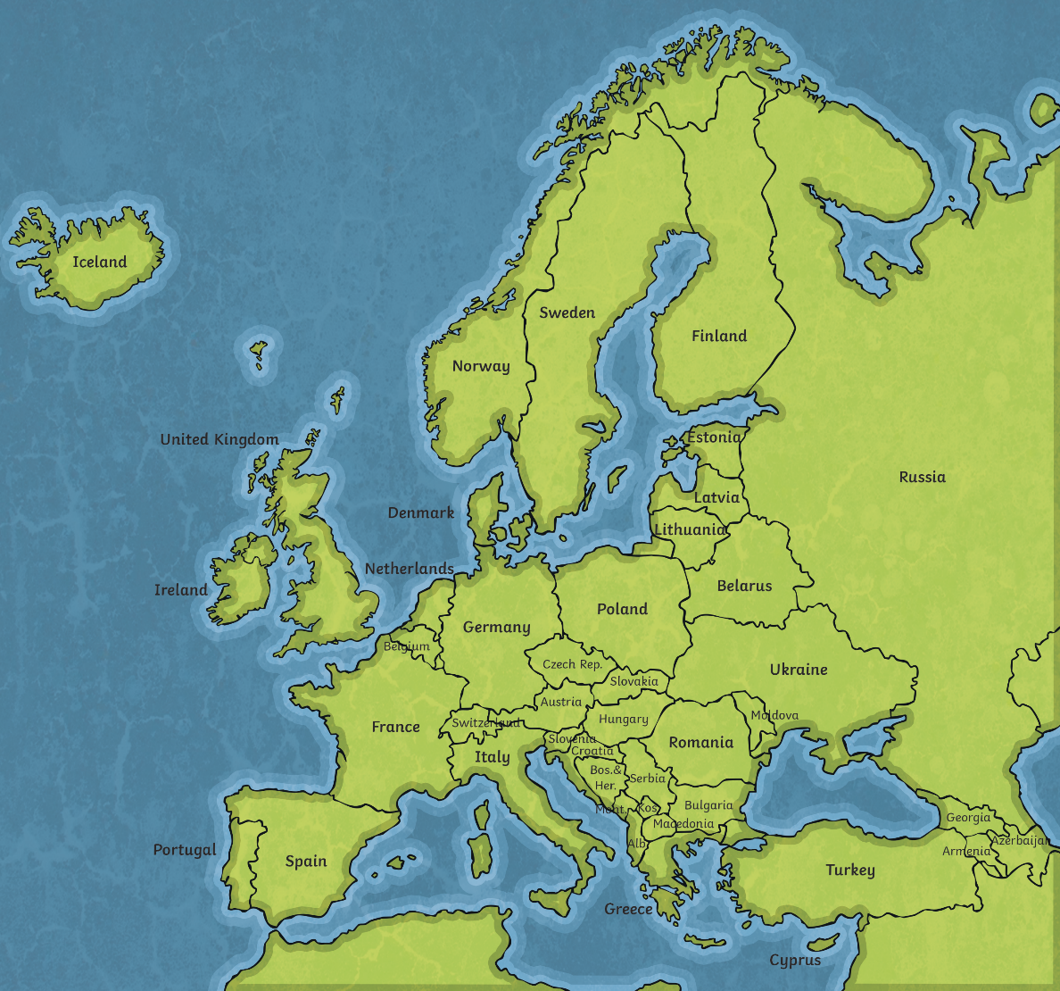
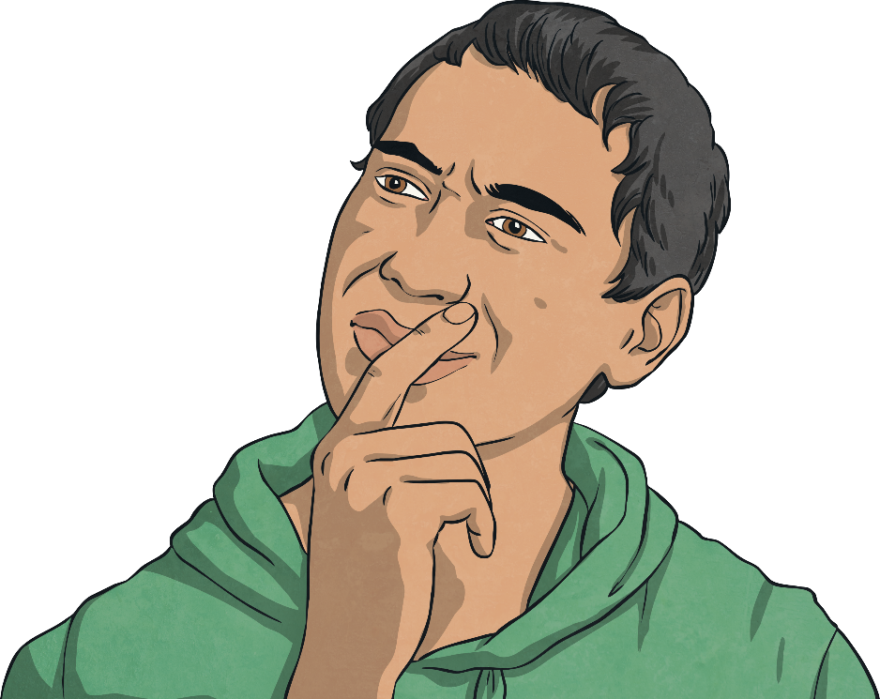
What Surrounds Us?
?
Where is the UK?
?
Can you find Austria?
On the map, THINK… how is the UK different to Austria?
?

Slide 4
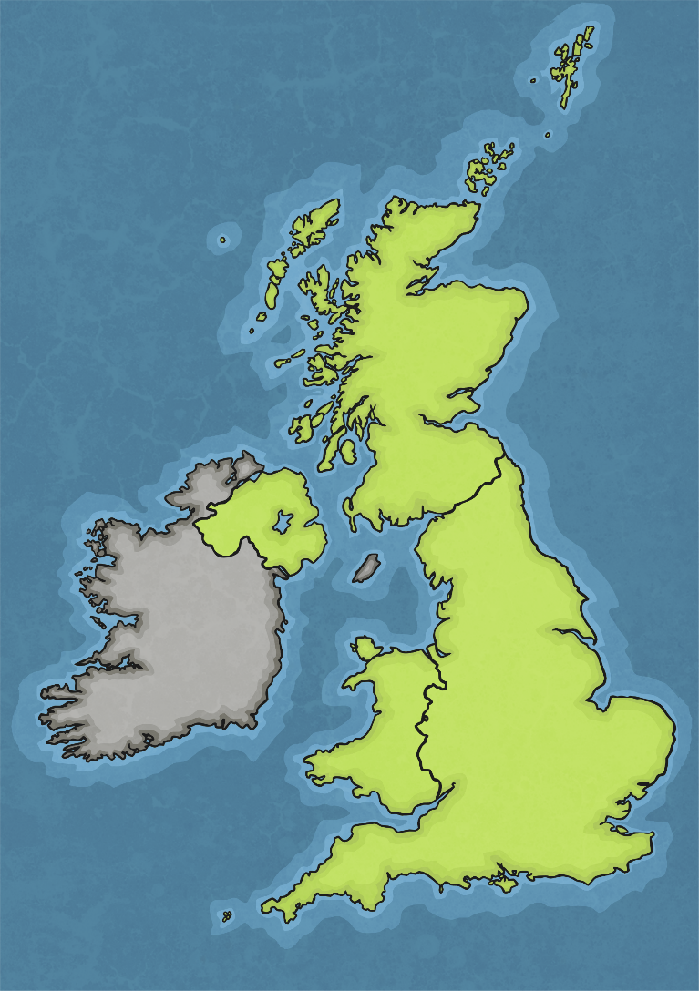
The Seas Around Us
Do you know where each label should go?
?
?
What clues might help us?
Irish Sea
English Channel
North Sea
Atlantic Ocean

Slide 5
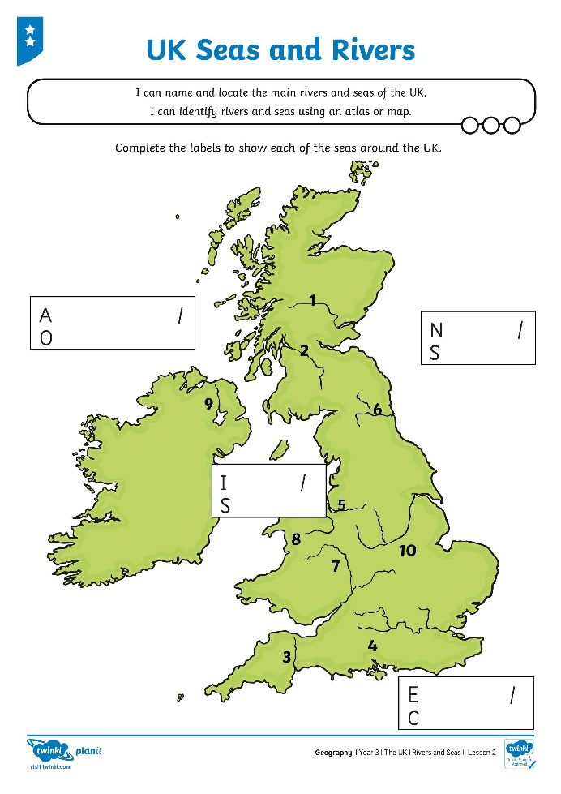
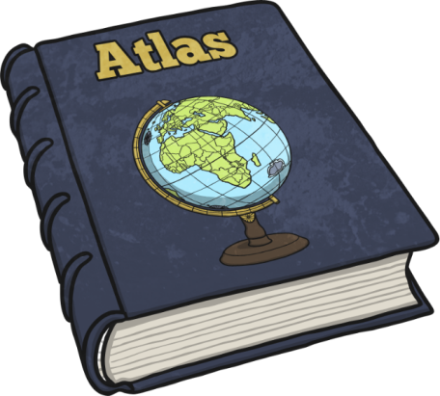
Seas Around the UK
Use your TOPIC maps from the school website…or find your own maps online…or use an ATLAS if you have one!

Slide 6
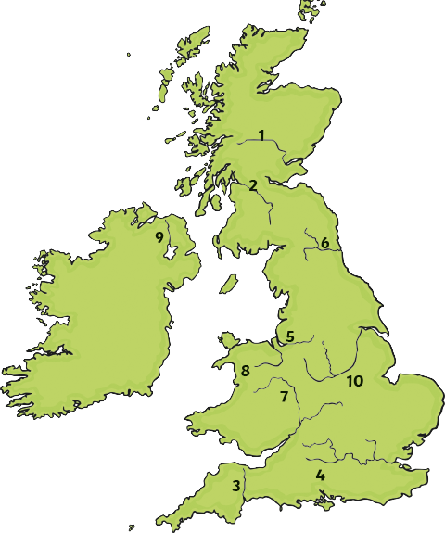
Rivers of the UK
Find out the names of the rivers labelled on your map of the UK.
?
Which seas do they flow into?

Slide 7
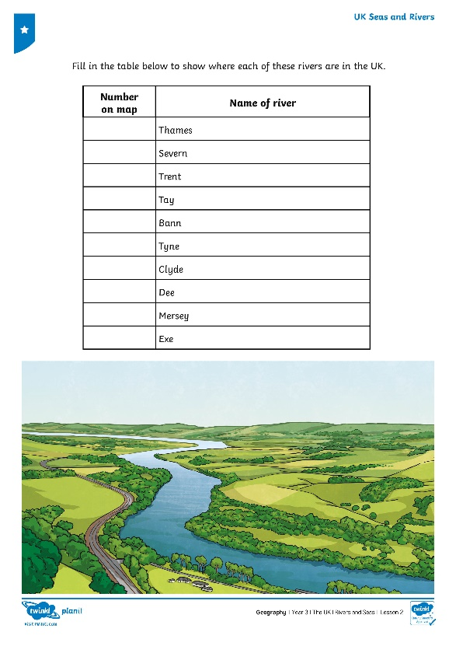
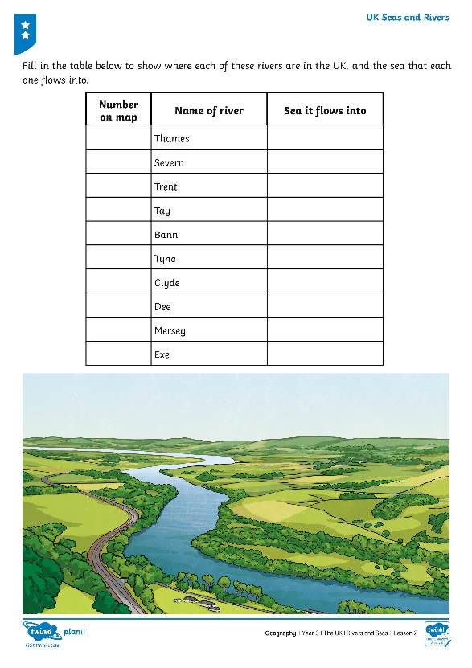
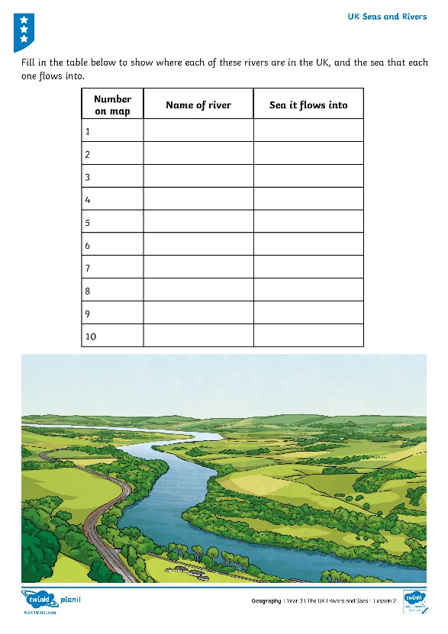
Rivers of the UK
Find out the names of the rivers labelled on your map of the UK.
!
Fill in the table to show where each of the rivers are in the UK.

Slide 8
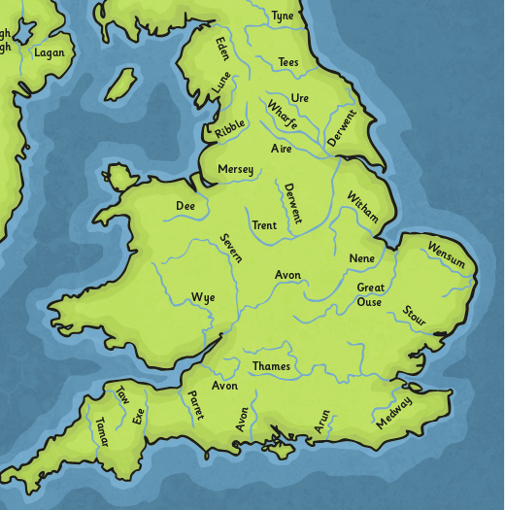
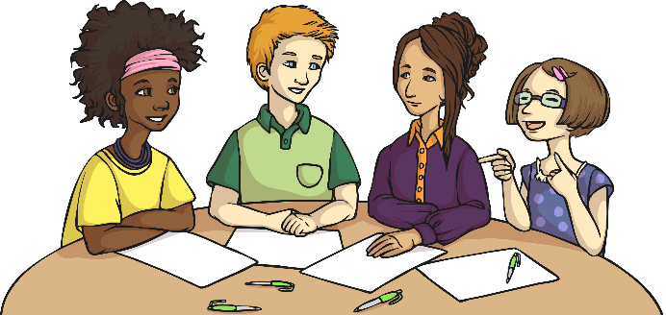
Where Do Rivers Go?
Can you find the River Thames?
?
?
Where does it start?
?
Where does it end?
What do you notice about where the rivers start and end?

