Slide 1
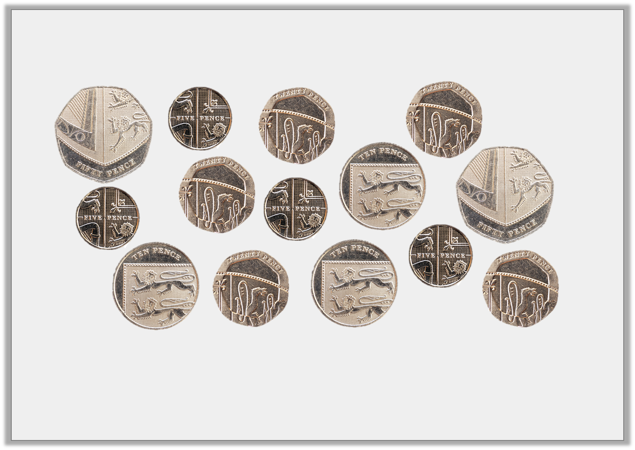
Find 4 ways to make a pound.

Slide 2
Complete the amounts to make them equal.
A. | 418p | = | ________ and ________
B. | __________ p | = | £5 and 92p
C. | £7 and 26p | = | __________ p

Slide 3
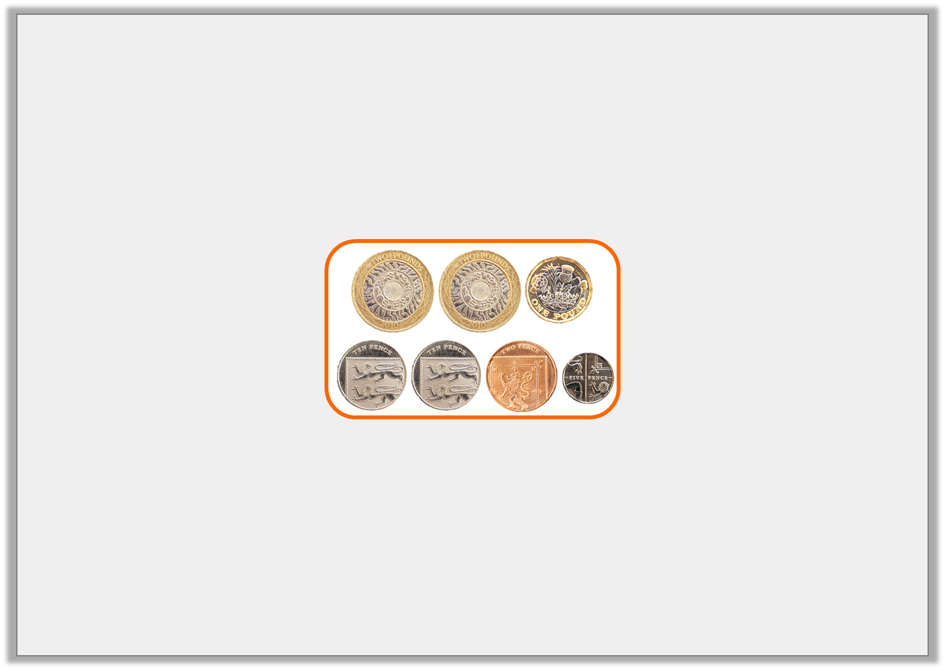
Which amount that will complete the statement.
823p
£7 and 9p
£7 and 81p | <

Slide 4
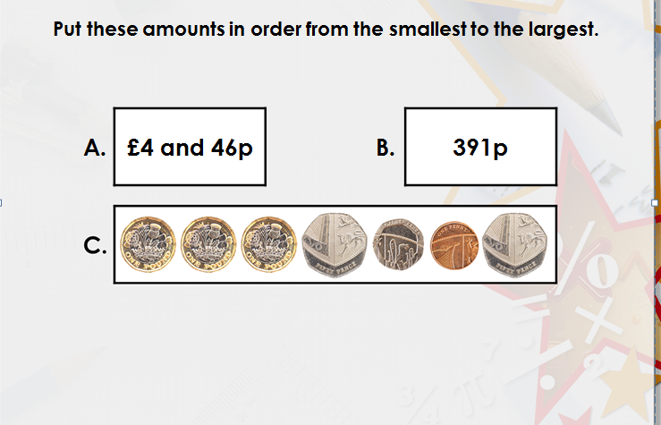
.
A.
£4 and 46p

Slide 5
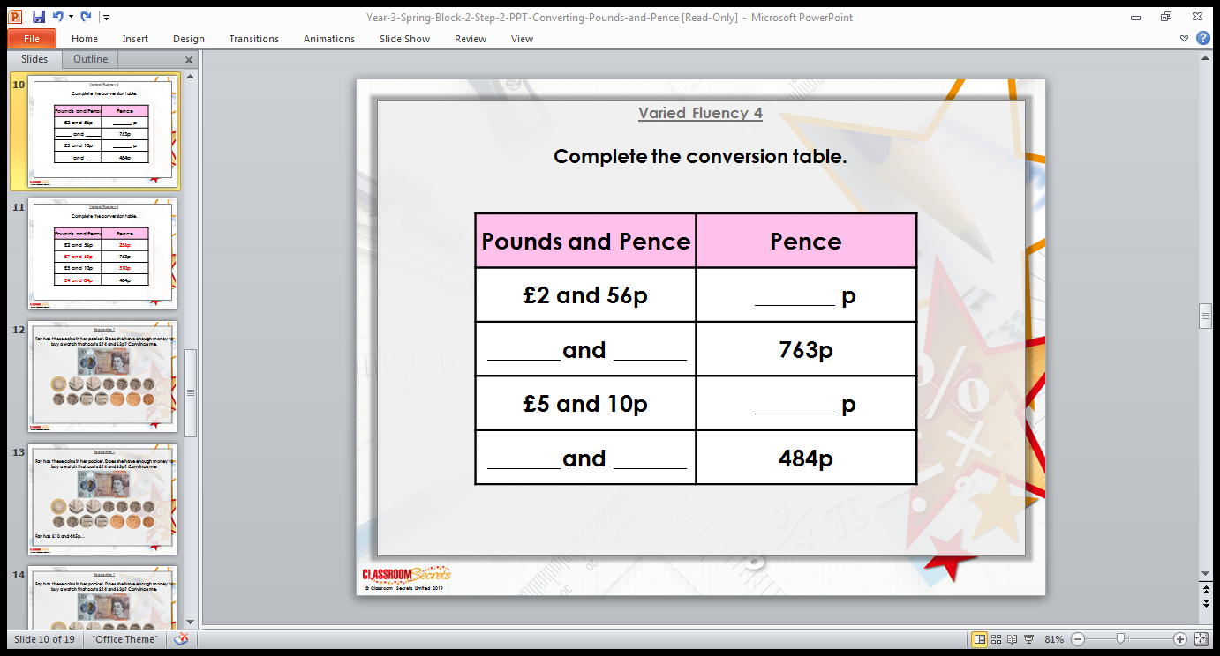

Slide 6
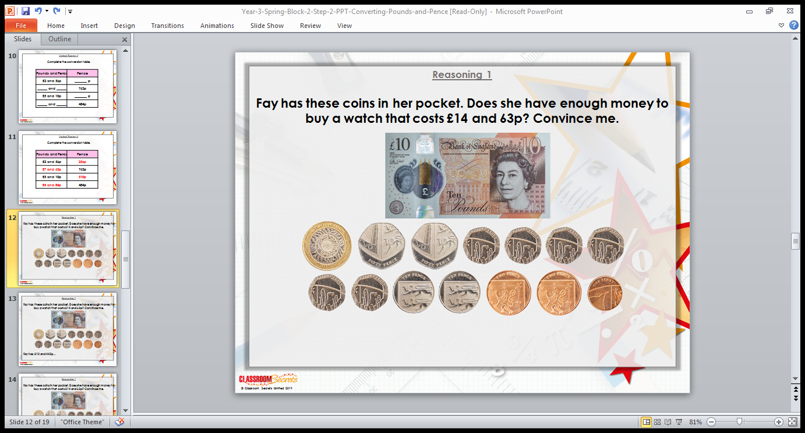

Slide 7
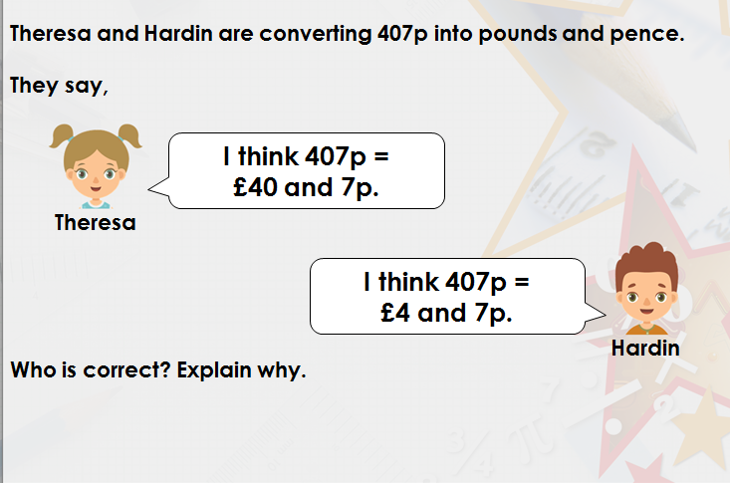

Slide 8


