Slide 1
Calculating Change
Aim
Add and subtract amounts of money to give change, using both £ and p in practical contexts.

Slide 2



Diving into Mastery Guidance
Each activity sheet is split into three sections, diving, deeper and deepest, which are represented by the following icons:
These carefully designed activities take your children through a learning journey, initially ensuring they are fluent with the key concept being taught; then applying this to a range of reasoning and problem-solving activities.
These sheets might not necessarily be used in a linear way. Some children might begin at the ‘Deeper’ section and in fact, others may ‘dive straight in’ to the ‘Deepest’ section if they have already mastered the skill and are applying this to show their depth of understanding.
Diving
Deeper
Deepest

Slide 3

Give Change
Diving
Carl buys a packet of pens for 54p. He pays with and 50p and a 20p coin. How much change should he receive? Complete the number line to help you.
6p
+
10p
w
w
54p
60p
70p
Carl received 16p change.

Slide 4
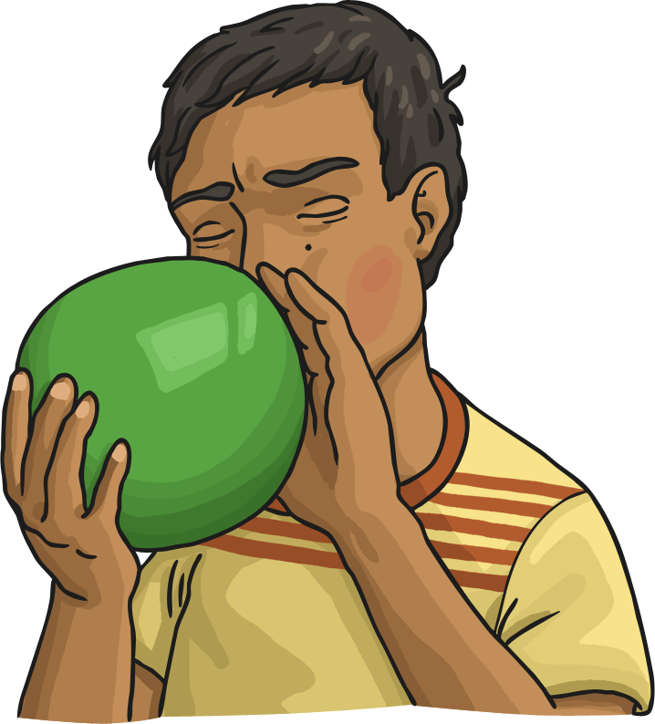
Give Change
Diving
Abraham is working out the change he will receive from £5 if he buys a balloon for £2 and 80 pence. He uses a part-whole model to partition the £5 into £4 and 100 pence. Complete the calculations to find the change.
£4 − £2 =
£2
£5
100p − 80p =
20p
Abraham receives change.
£2 and 20p
£4
100p

Slide 5






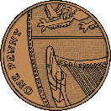
Give Change
Deeper
David bought a drink and paid with a £5 note.
He had fewer than 5 coins none of which were silver in his change. Which drink did he buy?
Cola
£2 and 85p
Orange Juice
£1 and 70p
Milkshake
£2 and 99p
David bought a milkshake.
£5 - £2 and 99p = £2 and 1p

Slide 6
Give Change
Deeper
José spent £12 and 65p at the post office.
He paid with a £10 note and a £5 note.
Which part-whole model would you use to help calculate the change José needs? Explain your reasons.
£15
£15
A
B
£10
£5
£14
100p
Model B allows you to calculate the change more easily by calculating £14 - £12 and 100p – 65p.
£14 - £12 = £2 and 100p – 65p = 35p so José needs £2 and 35p change.

Slide 7




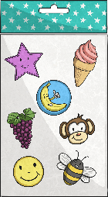
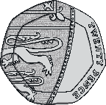

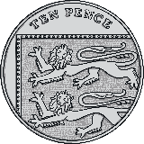
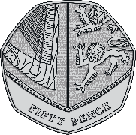
Give Change
Deepest
Alexa is selling gift sets containing two items.
30p
49p
£1 and 10p
55p
Jordan buys a pen and a notebook. He pays with two £1 coins. How much change does he need?
What coins could Alexa give him? Find three possibilities
He needs 60p change. There are many ways to make this, for example:

Slide 8
Give Change
Deepest
Alexa is selling gift sets containing two items.
30p
49p
£1 and 10p
55p
Alexa has these coins to give Benji as change for the items he bought.
What could Benji have bought?
Benji could have bought a pen and some stickers costing 79p or a notebook and stickers costing £1 and 59p.

Slide 9
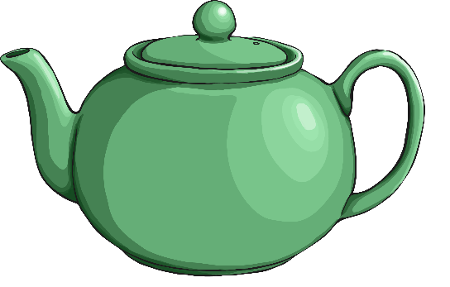


Give Change
Deepest
The café serves three different hot drinks: coffee, tea or hot chocolate.
Each drink costs less than £1.
Bryony pays for one of each drink with two £2 coins and gets £1 and 55p change.
Michael buys a tea and a coffee using a £2 coin and gets 30p change.
What could each drink cost? Find three possibilities.
The hot chocolate must cost 75p.
The total cost of the tea and the coffee must equal £1 and 70p.
There are many possible answers, for example:
Hot chocolate – 75p
Tea – 90p
Coffee – 80p
Hot chocolate – 75p
Tea – 74p
Coffee – 96p
Hot chocolate – 75p
Tea – 82p
Coffee – 88p

Slide 10


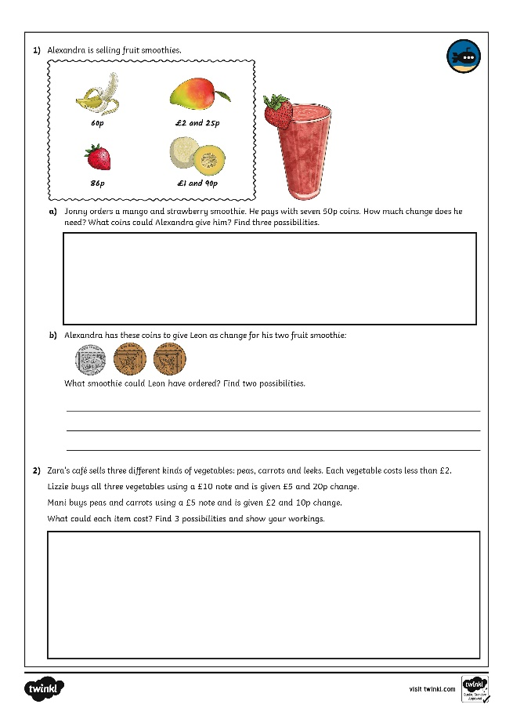
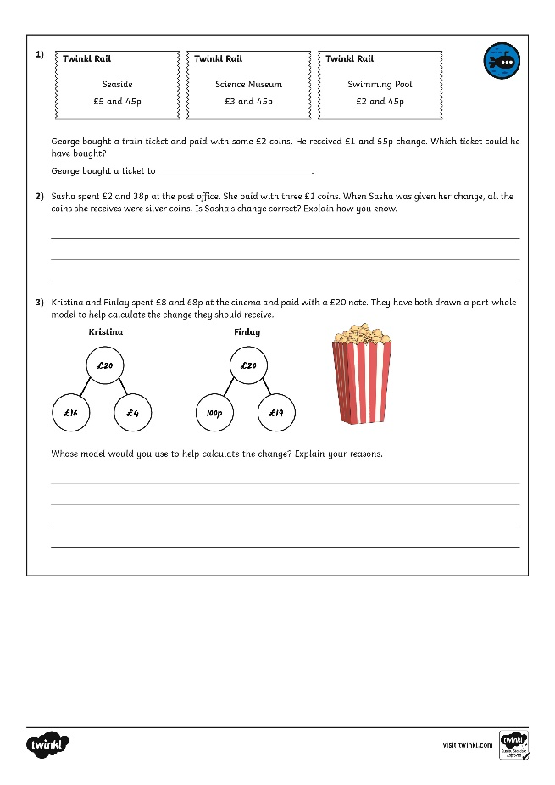
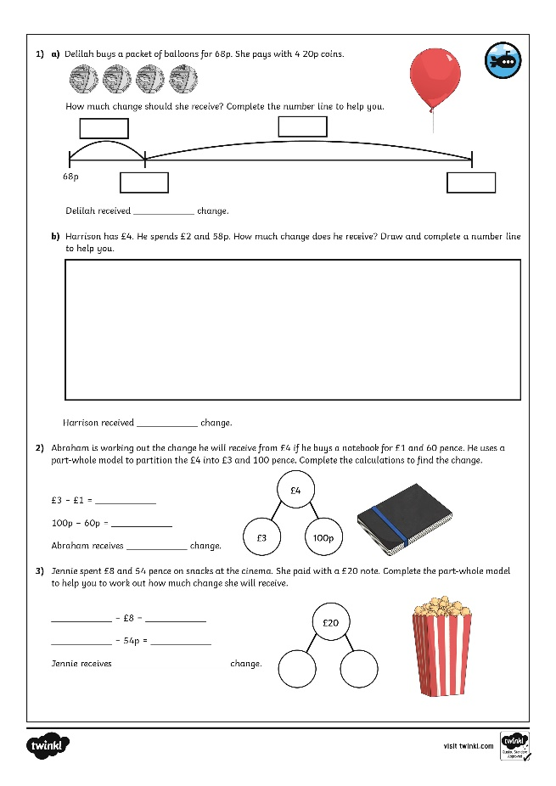
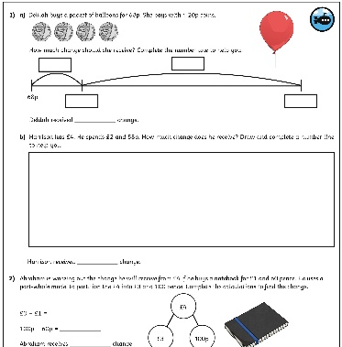
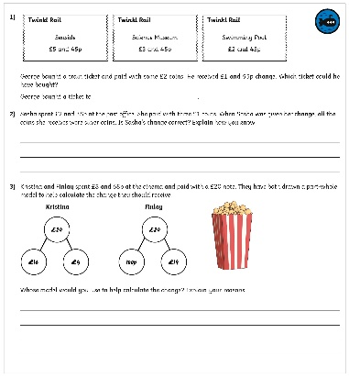
Give Change
Dive in by completing your own activity!

