Slide 2
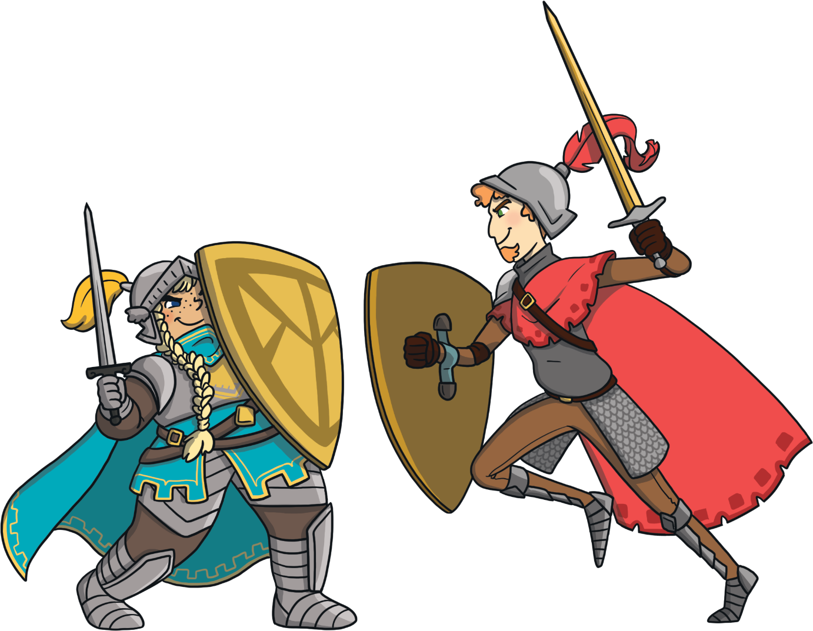
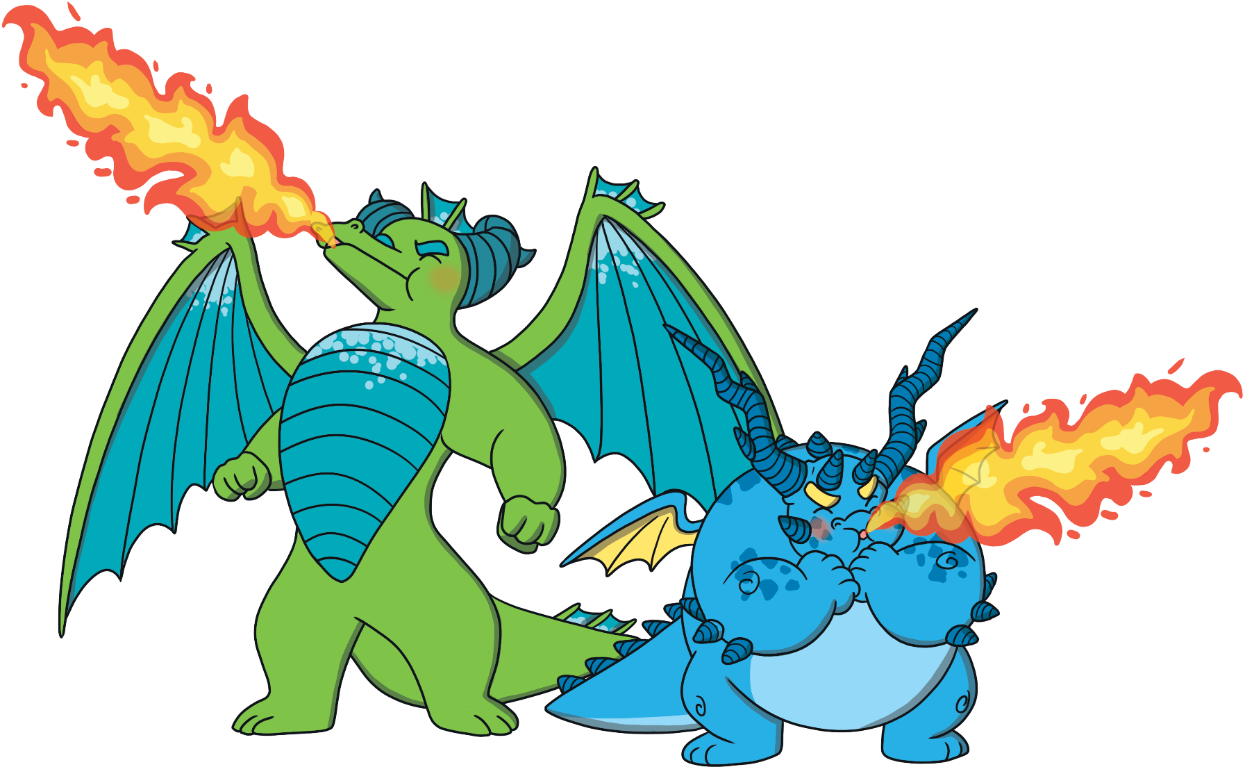
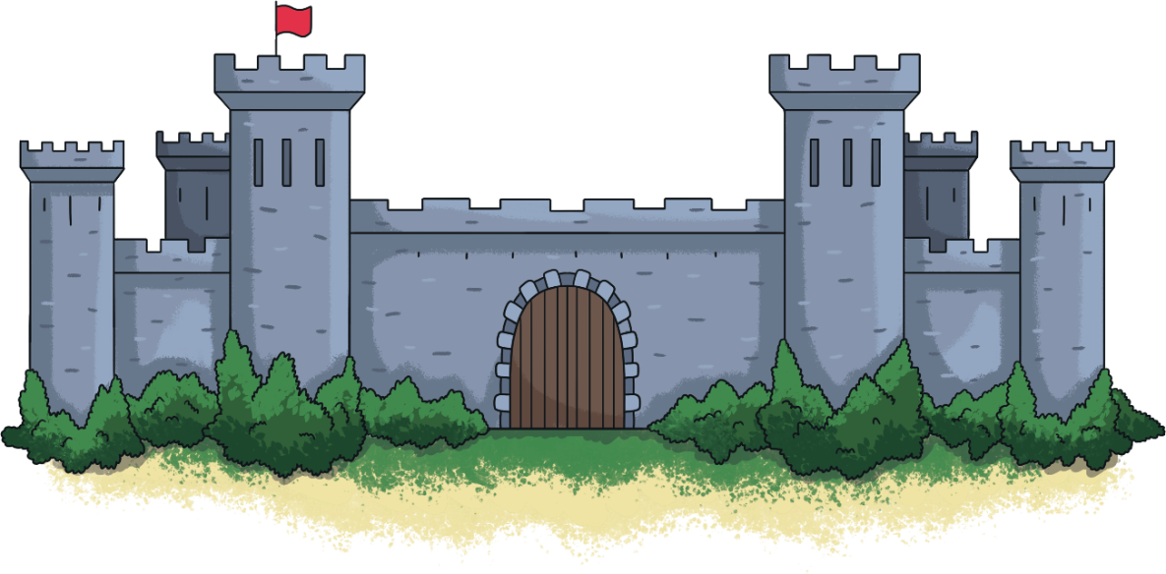
Dragons and Knights
Once upon a time, the knights of Stombart and the Dracton dragons were enemies.
The knights spent their time practising their sword skills, while the dragons worked on their fire-breathing technique.

Slide 3
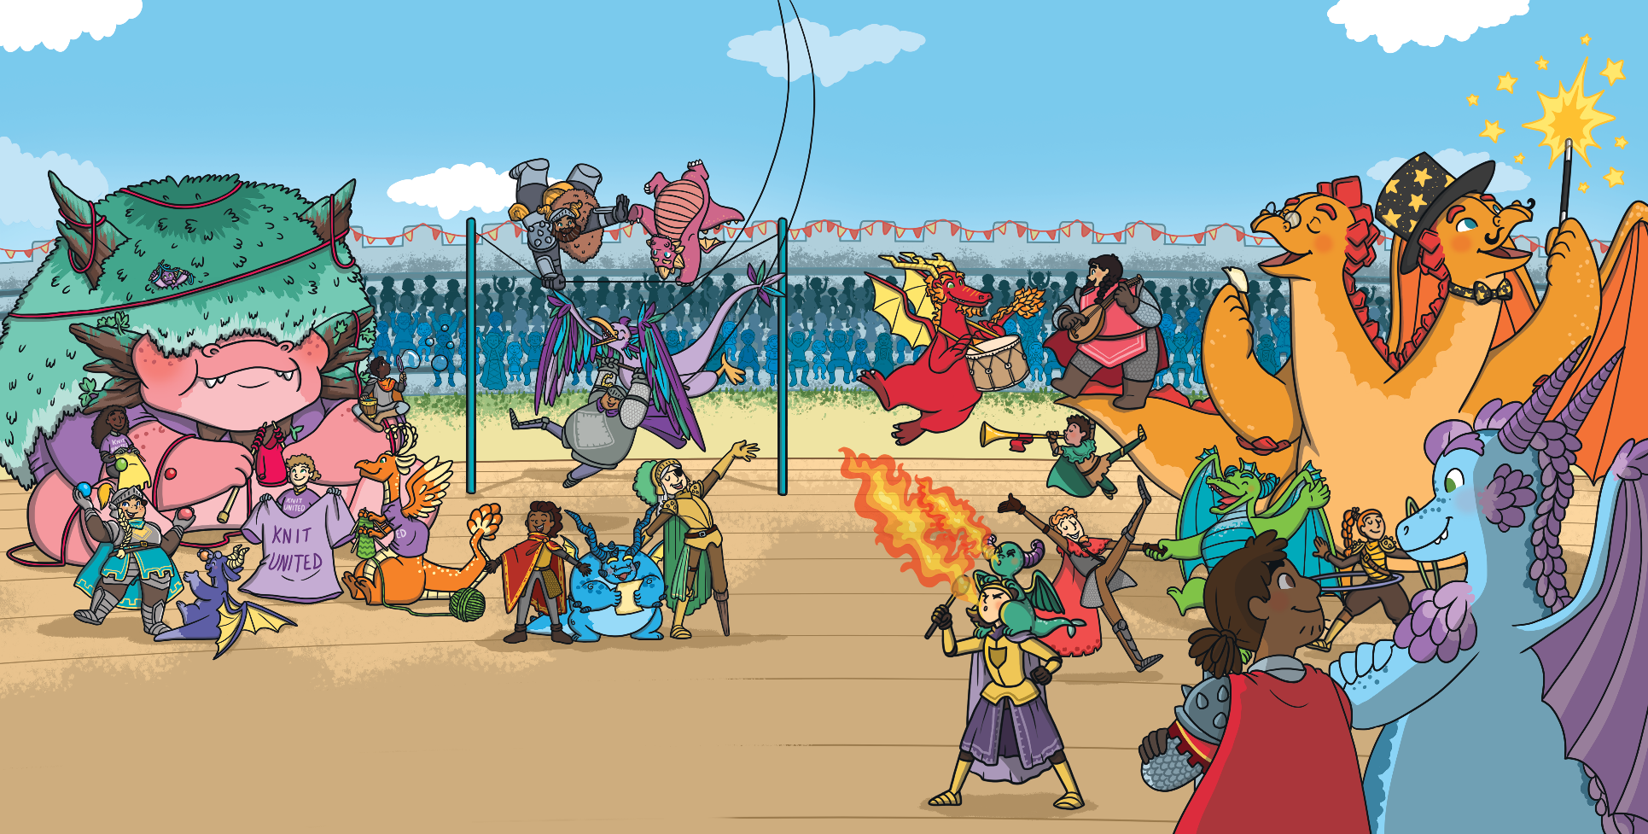
Dragons and Knights
Then, one day, they all came together to share their talents!
They held a talent show with dragons and knights performing.
They realised that they could be friends and they didn’t have to fight.

Slide 4
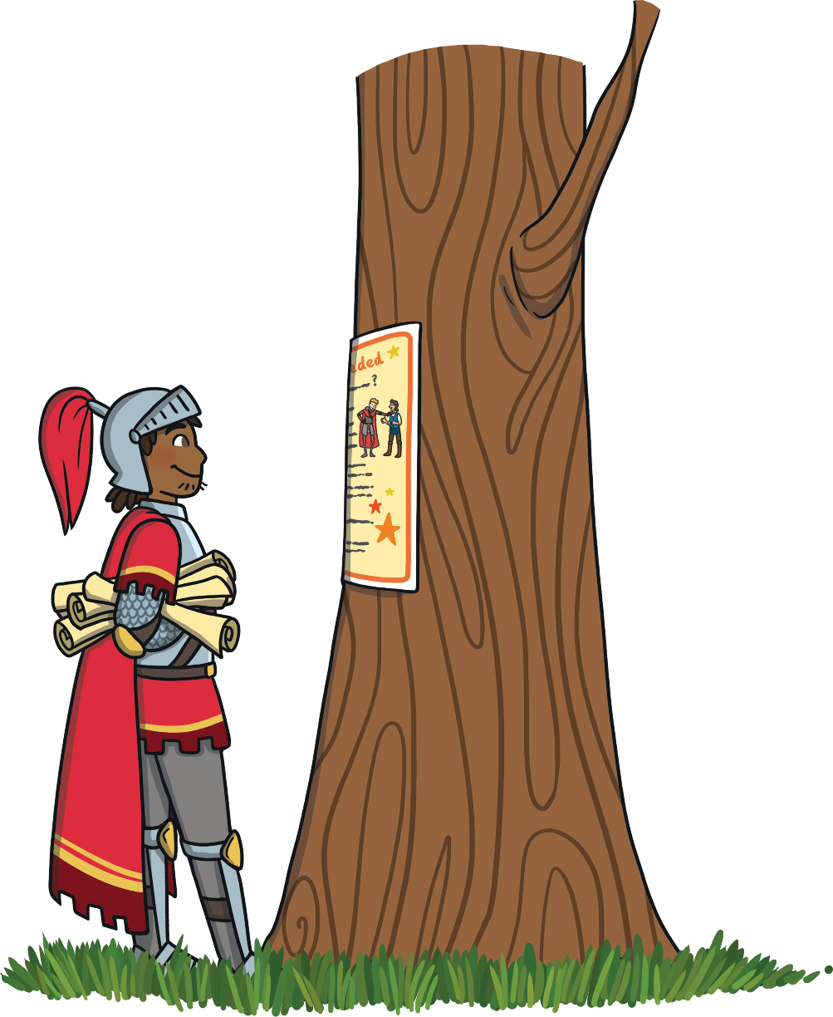
Performers Needed
Sir Gorrell has decided that the show is missing something.
He thinks that the show needs a comedian!
He makes a poster to advertise for a new performer.

Slide 5
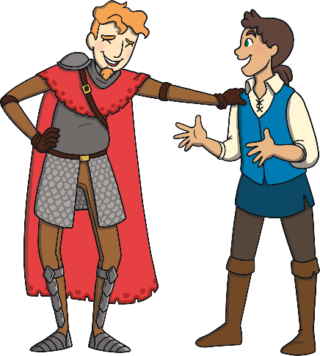
Persuasive Posters
Funny Knights Needed
Are you a hilarious comedian?
Let’s read the poster together.
What do you think the poster is trying to tell the reader to do?
We need you.
You could have the
chance to star in our amazing talent show.
Come and audition
at the castle.
Show us your best jokes.
Join our talented team.
What are you waiting for?
How exciting it would be to star in a show!

Slide 6
Persuasive Posters
Funny Knights Needed
Are you a hilarious comedian?
The poster is using different types of sentences to persuade comedians to audition for the show.
We need you.
You could have the
chance to star in our amazing talent show.
Come and audition
at the castle.
Show us your best jokes.
Join our talented team.
What are you waiting for?
How exciting it would be to star in a show!

Slide 7
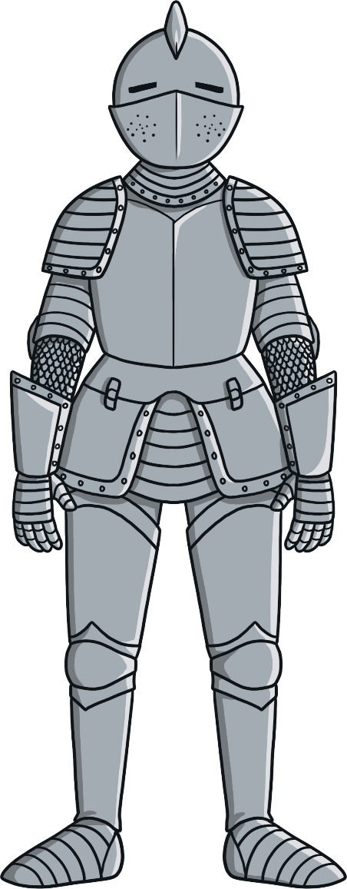
Types of Sentences
Statements
Statements are sentences which tell you something, like a fact. They should contain a verb, a noun and usually end with a full stop.
Knights wear armour.
In a persuasive poster, the statement might tell the reader how brilliant something is.
Knights wear beautiful suits of armour made of strong metal.

Slide 8

Types of Sentences
Questions
Questions are sentences that ask you something.
They usually end with a question mark.
Do you like dragons?
A persuasive poster might ask a
question that sounds like we should
give one obvious answer, usually yes or no.
Can you think of anything more exciting than a fire-breathing dragon?

Slide 9
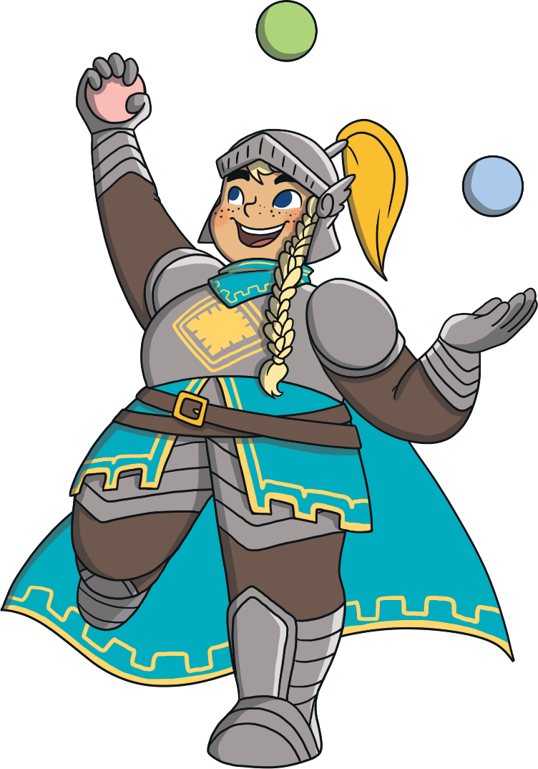
Types of Sentences
Commands
Commands are sentences that tell you to do something. They are found in instructions and start with an imperative verb (bossy word).
Watch the juggler.
In a persuasive poster, the command might be telling us to do or buy something.
Come to the spectacular juggling show.

Slide 10
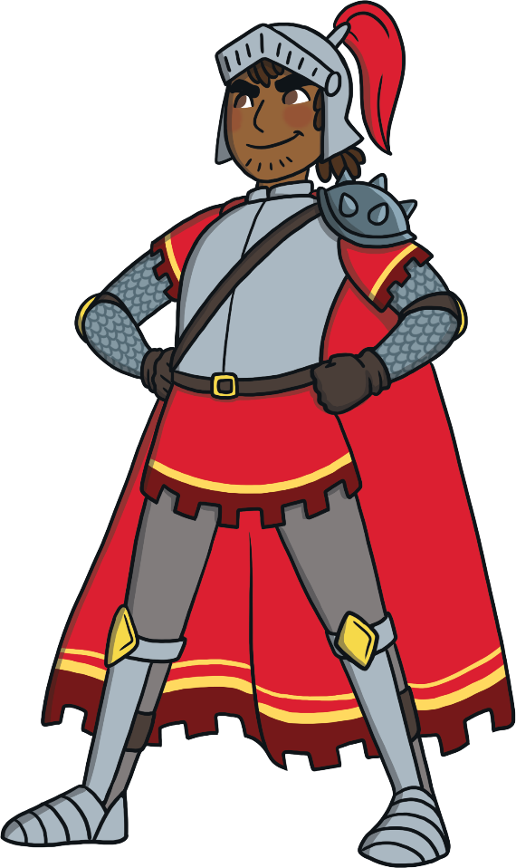
Types of Sentences
Exclamations
An exclamation is a sentence beginning with ‘What’ or ‘How’. It is a full sentence, including a verb, which ends with an exclamation mark.
What a cool knight he is!
In a persuasive poster, the exclamation sentence might be used to make it seem like the writer truly thinks something is amazing.
What an incredibly brave knight he is!
How special it would be to watch
an amazing talent show!

Slide 11
Types of Sentences
Funny Knights Needed
Can you spot the different types of sentences in
the poster?
Statement
Question
Command
Exclamation
Are you a hilarious comedian?
We need you.
You could have the
chance to star in our amazing talent show.
Come and audition
at the castle.
Show us your best jokes.
Join our talented team.
What are you waiting for?
How exciting it would be to star in a show!

Slide 12
Types of Sentences
Funny Knights Needed
Question
Are you a hilarious comedian?
Statement
We need you.
You could have the
chance to star in our amazing talent show.
Come and audition
at the castle.
Show us your best jokes.
Join our talented team.
What are you waiting for?
How exciting it would be to star in a show!
Statement
Command
Command
Command
Question
Exclamation

Slide 13
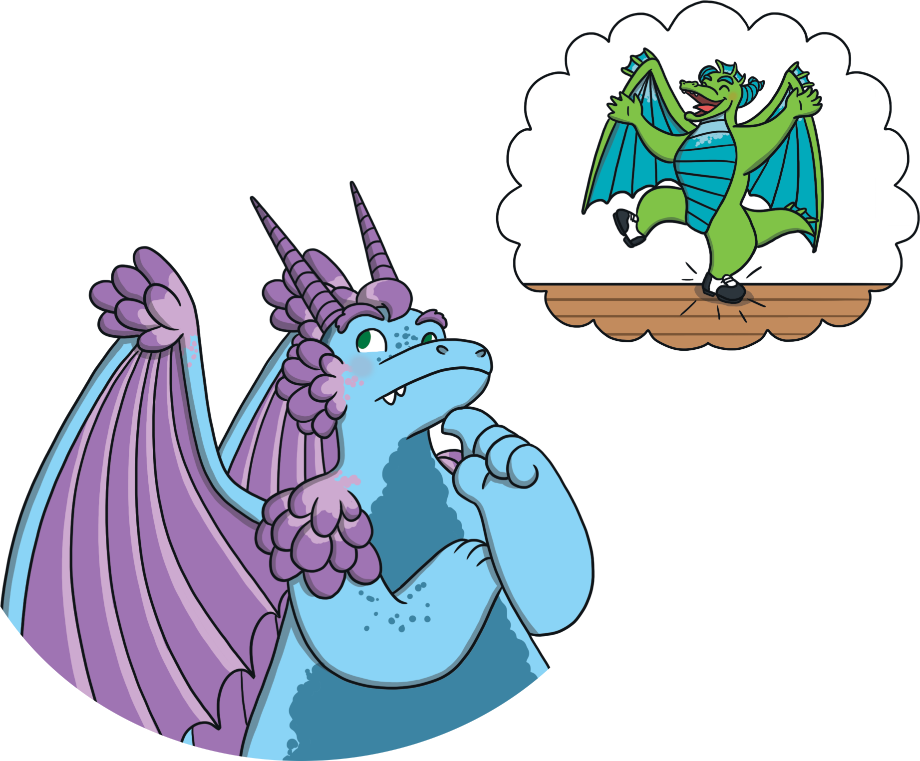
Dancer Required
Aristar decides that the show needs a tap-dancing dragon!

Slide 14
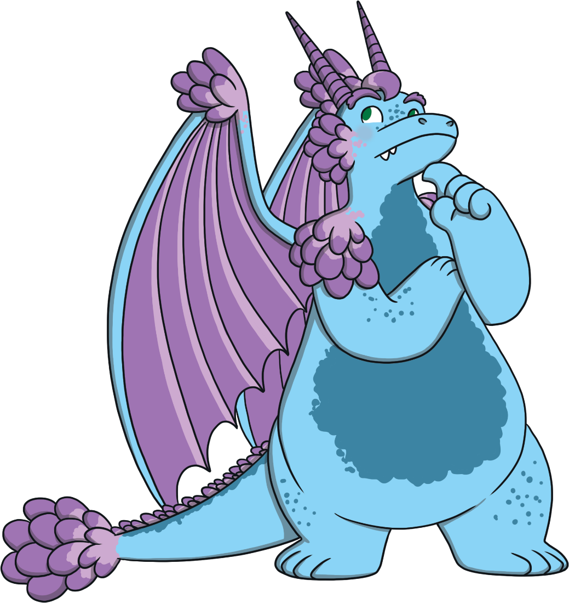
Dancer Required
Can you help Aristar to make a poster advertising for a dancing dragon?
Include these different sentence types:
Statement
Question
Command
Exclamation
Can you include
one of each?

Slide 15
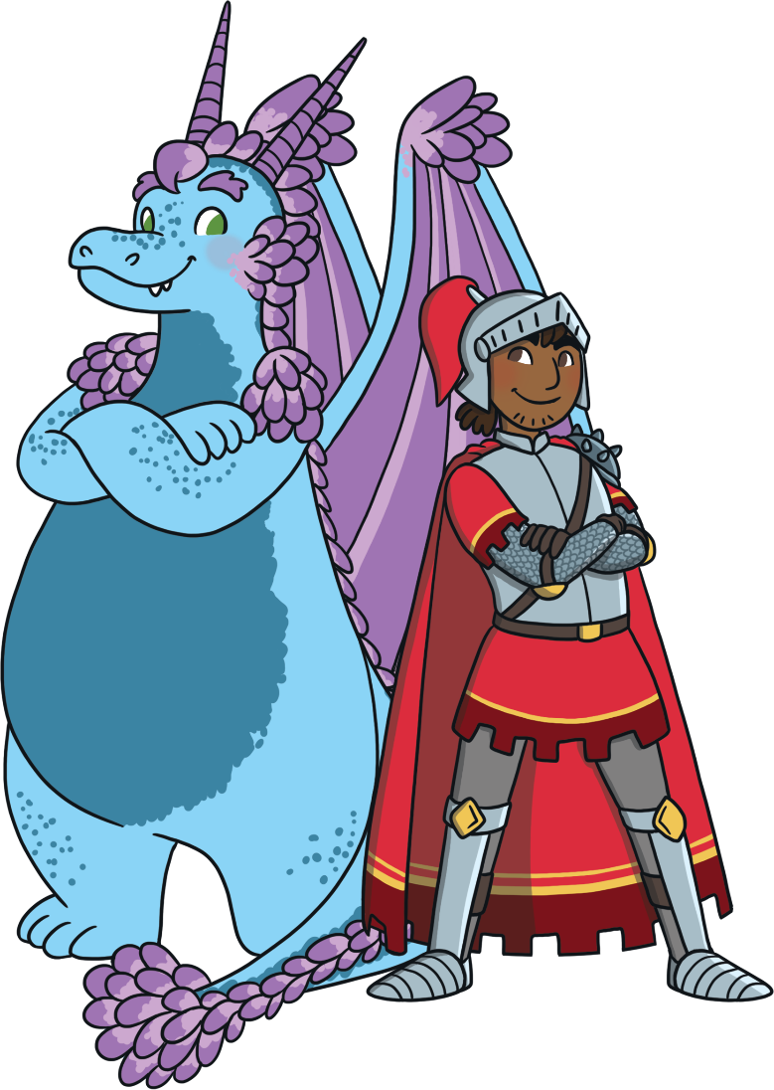
Poster Review/Check
THINK and CHECK.
Can you find one of each sentence type in your poster?
Statement
Example: Knights wear armour.
Question
Example: Do you like dragons?
Command
Example: Watch the juggler.
Exclamation
Examples: What a cool knight he is!
How special it would be to watch an
amazing talent show!

