Slide 1
Addition word problems

Slide 2
Quick Fire Addition
Choose one of the columns to try and work out the answers as quick as you can
7 + 9 = 13 + 24 = 24 + 105 =
6 + 12 = 33 + 45 = 134 + 154 =
15 + 16 = 65 + 34 = 234 + 435 =
14 + 19 = 74 + 29 = 324 + 437 =

Slide 3
Quick Fire Addition Answers
Yellow + Green Purple + Blue Red + Gold
7 + 9 = 16 13 + 24 = 37 24 + 105 = 129
6 + 12 = 18 33 + 45 = 78 134 + 154 = 288
15 + 16 = 31 65 + 34 = 99 234 + 435 = 669
14 + 19 = 33 74 + 29 = 103 324 + 437 = 761

Slide 4
RUCSAC
R –
U –
C –
S –
A –
C –
Read
Understand
Choose
Solve
Answer
Check

Slide 5
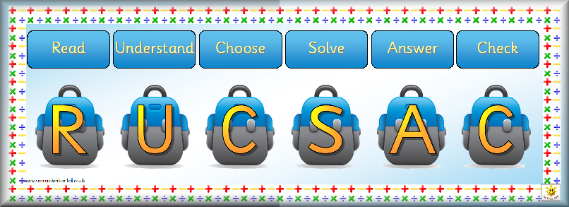
At a dance there are 15 boys and 17 girls. How many altogether?
15 + 17 =
32

Slide 6
In a shop James brought 2 T-shirts. The first T-shirt cost 58p and the second T-shirt cost 33p. How much did he spend?
58 + 33 =
91p

Slide 7
A banana weighs 100 grams. A pear weighs 125 grams and an orange weights 72 grams. How much do they weigh altogether?
100 + 125 + 72 =
297 grams

