Slide 2
National Curriculum Objective
Draw 2-D shapes and make 3-D shapes using modelling materials; recognise 3-D shapes in different orientations and describe them.

Slide 3

Recognise and Describe 2D Shapes
Diving
Describe one of the shapes below. Think about the sides and vertices (corners).
oval
circle
trapezium
triangle
heptagon
nonagon
octagon
semi-circle
square
decagon
hexagon
pentagon
rectangle

Slide 4


Recognise and Describe 2D Shapes
Diving
Which of these descriptions match this shape?
I have 5 straight sides.
I have 6 angles.
I am a hexagon.
I have 6 straight sides.
I have 8 angles.
I am a pentagon.
I have 8 straight sides.
I have 5 angles.
I am an octagon.

Slide 5

Recognise and Describe 2D Shapes
Diving
Which of these descriptions match this shape?
I have 5 straight sides.
I have 6 angles.
I am a hexagon.
I have 6 straight sides.
I have 8 angles.
I am a pentagon.
I have 8 straight sides.
I have 5 angles.
I am an octagon.

Slide 6



Recognise and Describe 2D Shapes
Deeper
Can you think of a shape which:
has two pairs of equal sides;
has four equal angles;
is symmetrical?
rectangle

Slide 7
Recognise and Describe 2D Shapes
Deeper
True or false? An octagon always has eight sides but doesn’t always have eight angles.
False! A 2D shape made of straight lines always
has the same number of angles as sides.

Slide 8

Recognise and Describe 2D Shapes
Deepest
Which shapes below are pentagons?
How do you know?

Slide 9


Recognise and Describe 2D Shapes
Deepest
What do these shapes have in common?
They all have a curved side.
What are some differences between them?
One has a straight side.
Some are symmetrical even when they are turned round. (If they were made of paper, they could be folded exactly in half in more than one direction.)

Slide 10


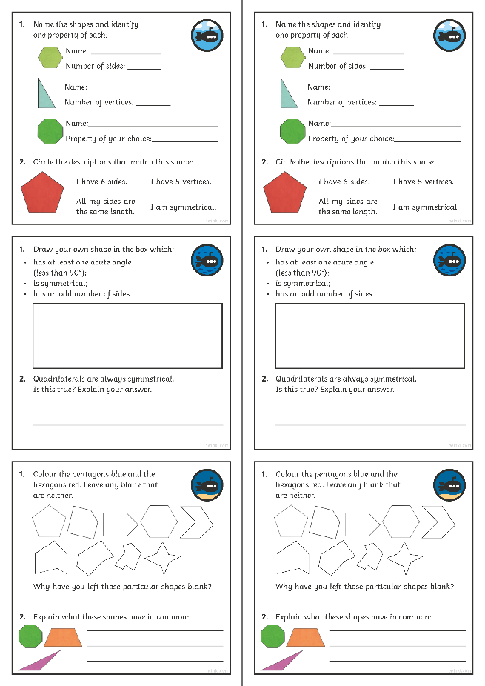
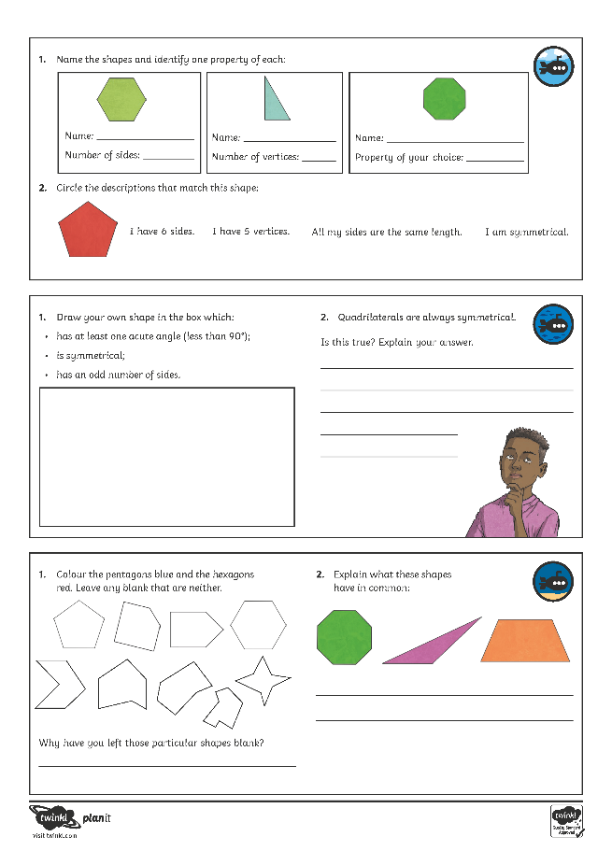
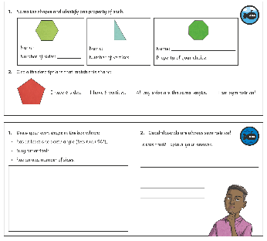
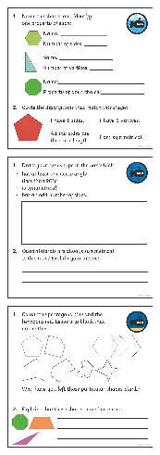
Recognise and Describe 2D Shapes
Dive in by completing your own activity!

