Slide 1

Maps as Story-Starters
With Cressida Cowell, author of
How to Train Your Dragon

Slide 2
How to Train Your Dragon by Cressida Cowell
Chapter 1 https://vimeo.com/507420868/cdbbc5001e

Slide 3
Task 1: Instructions
Mission: Write a set of directions which will explain to your reader how to navigate from one setting to another on your map.
Task 2: Setting Description
Mission: Write a description of one or more of the settings that you have included on your map.
Task 3: Short Story
Mission: Create your own short story in the style of How to Train Your Dragon by Cressida Cowell.

Slide 4
Cressida Cowell’s
Maps as Story-Starters
You will need:
- paper
- pencil
https://vimeo.com/510248219/18b0d7e1a6

Slide 5
Let’s look at the example maps shared again.
As we go through, note down any ideas that you could magpie to include in your own map.

Slide 6
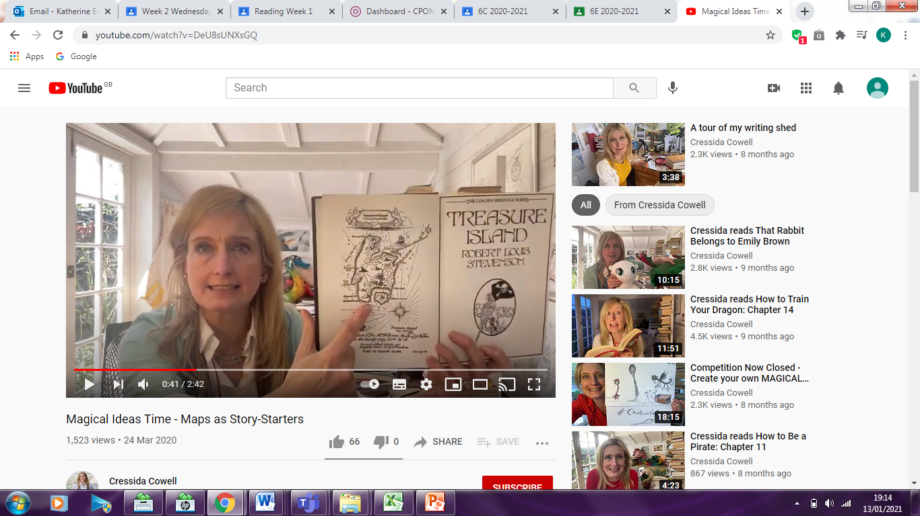
What illustrations has Robert Louis Stevenson included in his map to help bring it to life?
What do you notice is in the bottom right corner of his map? Why do you think that has been included? What are they used for?

Slide 7
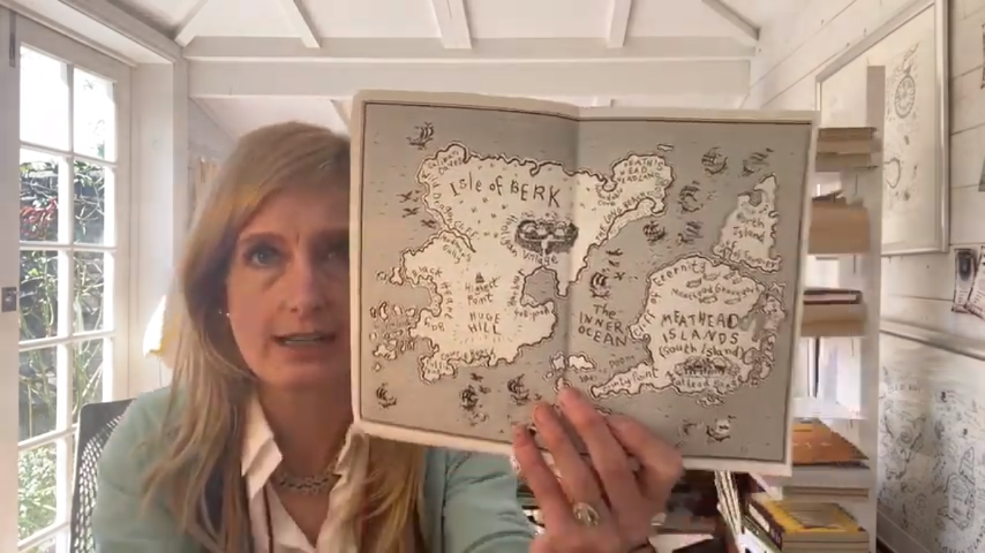
What illustrations has Cressida Cowell included in her map?
How does it compare to the last one that we looked at? What are the similarities and differences? Considering the type of story that it is, why do you think there are those differences?
What writing has she included in her map? Why?

Slide 8
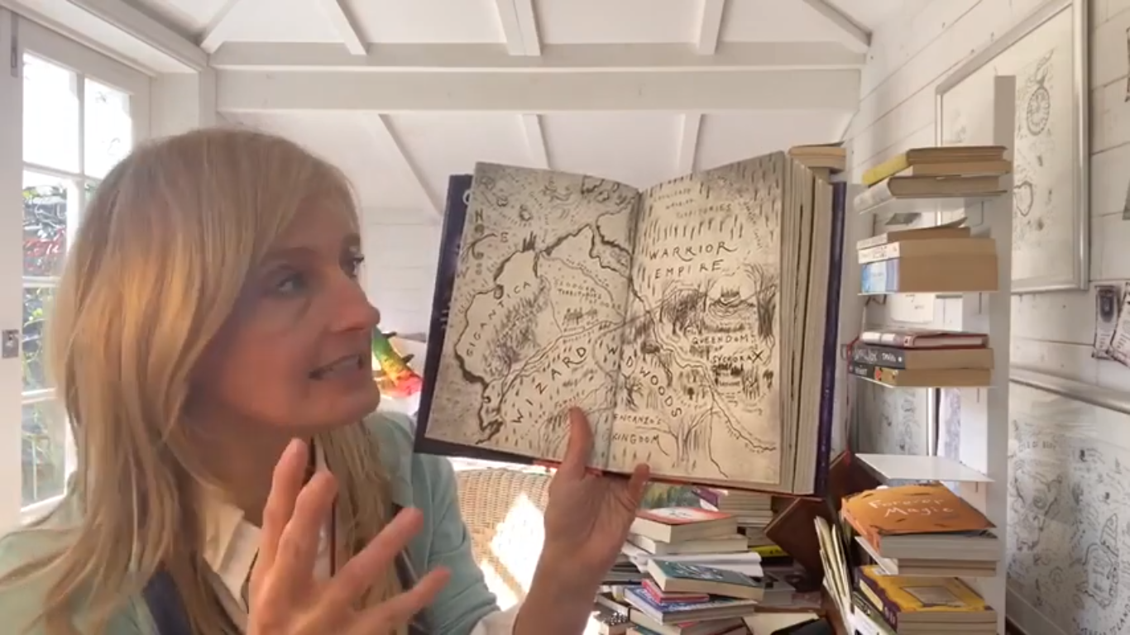
This is another map by the same author.
What differences can you see?
What impact do they have on your interpretation of the map?

Slide 9
Task 1: Instructions
Mission: Write a set of directions which will explain to your reader how to navigate from one setting to another on your map.
Consider how you will ensure that all of the settings and features of your map are included within your instructions and that their location is clear.
Before you write:
Can you clearly explain how to navigate from one location to another?
Which unusual landmarks on your map do you need to include in your instructions?
What key language will you need to use?

Slide 10
Task 1: Instructions
Planning your write:
Look back at the map you created after watching the video by Cressida Cowell. Which locations are most important? Which locations would it be an interesting journey to move between?
Look at a model set of directions. Note key language and how the text has been organised (particularly focus on the use of commands). Highlight and annotate the model with vocabulary that you will use in your own writing.
Role play walking through your map. What direction do you need to turn in? What can you see around you when you turn in that direction? Are there any unusual features that would help the reader to recognise where they are?
Discuss different ideas about your instructions with a friend or adult.
Say out loud what you are going to write before you commit it to paper.

Slide 11

Task 1: Instructions
After you have written:
Read your instructions aloud. Are they clear and concise?
Look carefully at the different types of punctuation in your writing. Is it placed and used accurately?
Notice the organisational devices you have used. Do they make your text easy to read and follow?
Identify the key language in your writing. Have you chosen precise words to make your meaning clear?
Read the whole text through. Does it flow? Does it feel like one piece of writing? If not, what could you add or move to make it feel like one piece of writing?
Look at the types of sentences that you have used. Are they suitable for the text type?

